Slide 1
Michael Allen Sprint #2 Review
Write a Script in “R” to Connect to a “End of Sprint Survey” Created in Google Forms

Slide 2
Game Plan
1. Create "End of Sprint Survey" in Google Forms
2. Fill out the “Google Form” Multiple times to Create “Mock Data”
3. Analyze the Results in “Google Forms”
4. Create a Spreadsheet in “Google Sheets”
5. Use R to read the “Google Sheet”
6. Write a “Script” in R to Speed-up the Process of Reading a Google Sheet into “R”
7. View the (Survey) Data in R

Slide 3
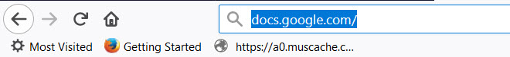
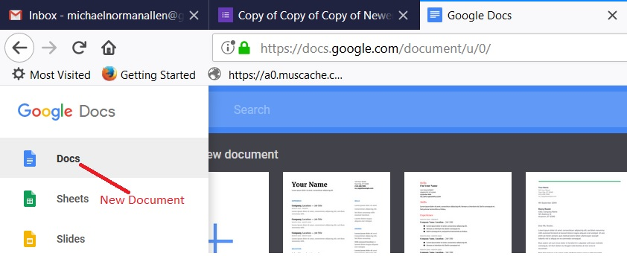
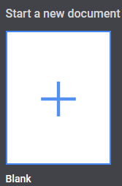
Accessing Google Forms

Slide 4
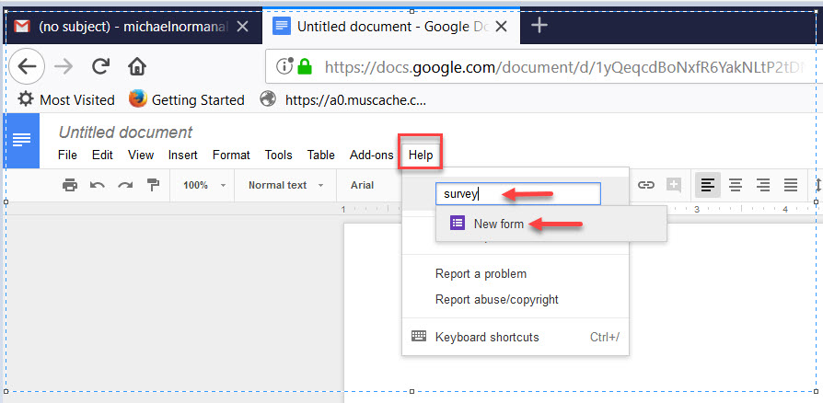
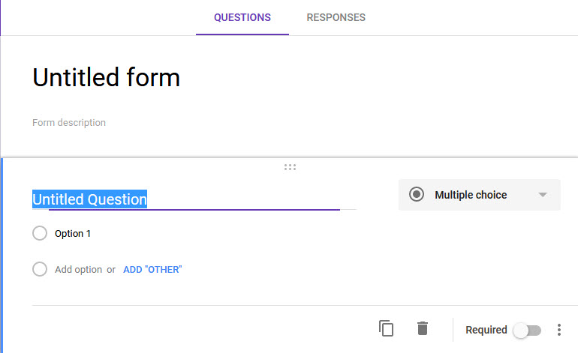
Accessing Google Forms II

Slide 5
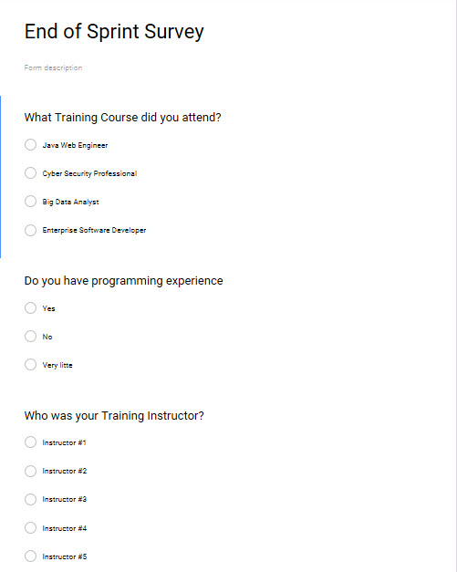
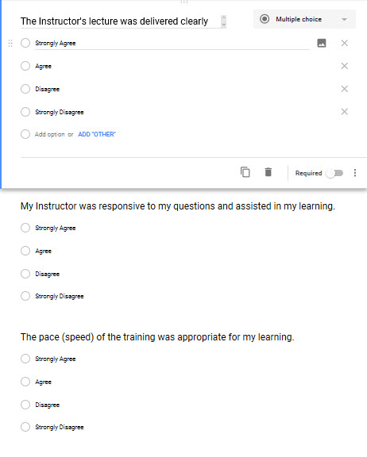
Create "End of Sprint Survey" in Google Forms

Slide 6
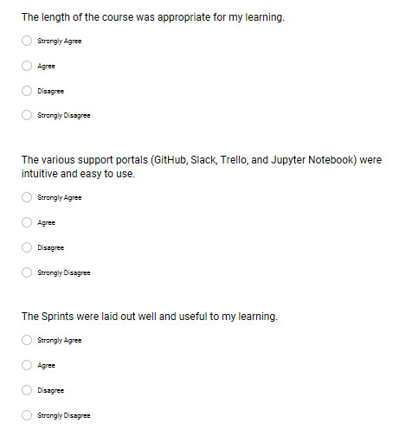
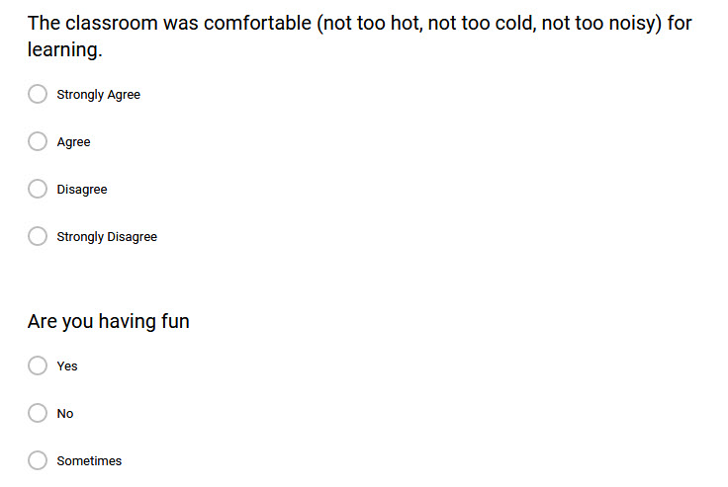
Create "End of Sprint Survey" in Google Forms II

Slide 7
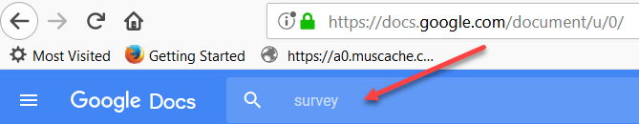
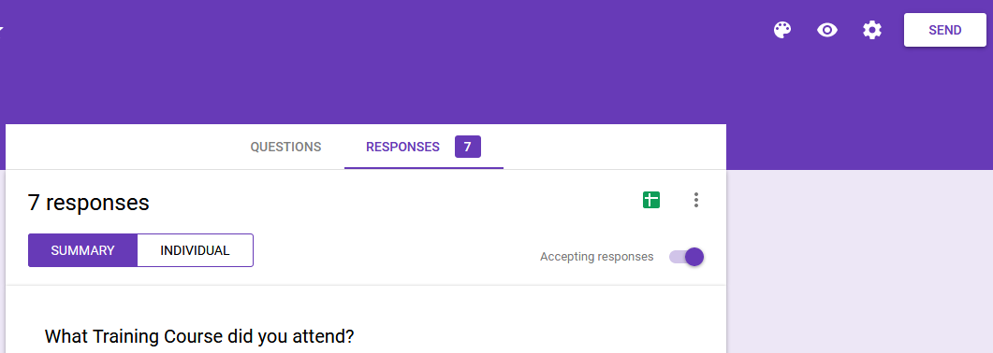
Accessing the End of Sprint Survey (for Mock Data)

Slide 8
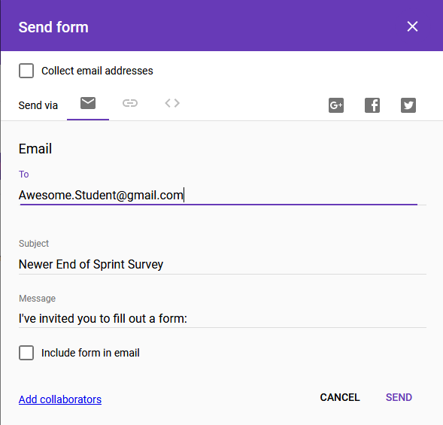
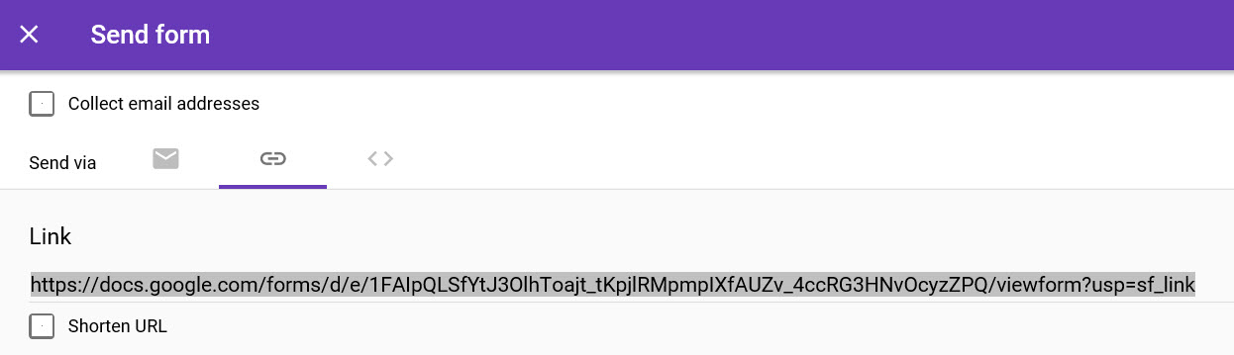
Accessing the Sprint Survey via Email or URL
URL

Slide 9
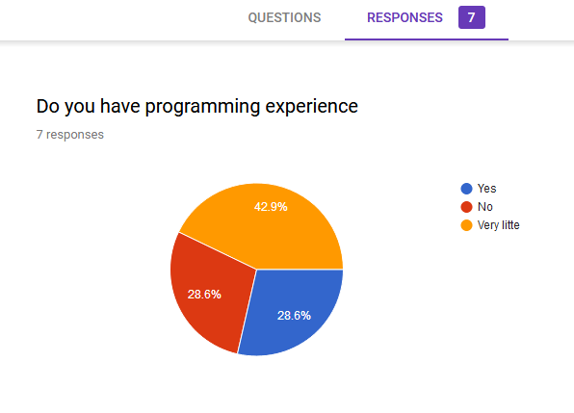
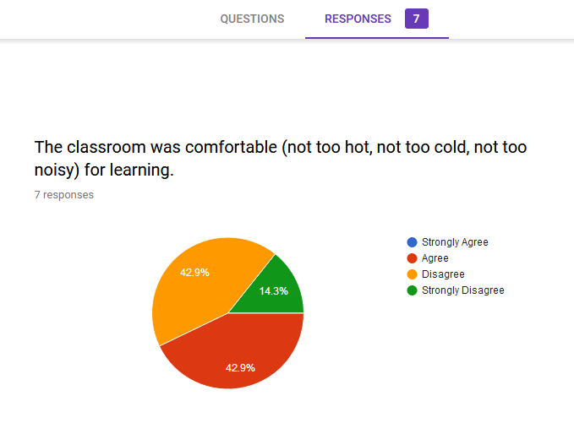
Analyze the Results in “Google Forms”

Slide 10
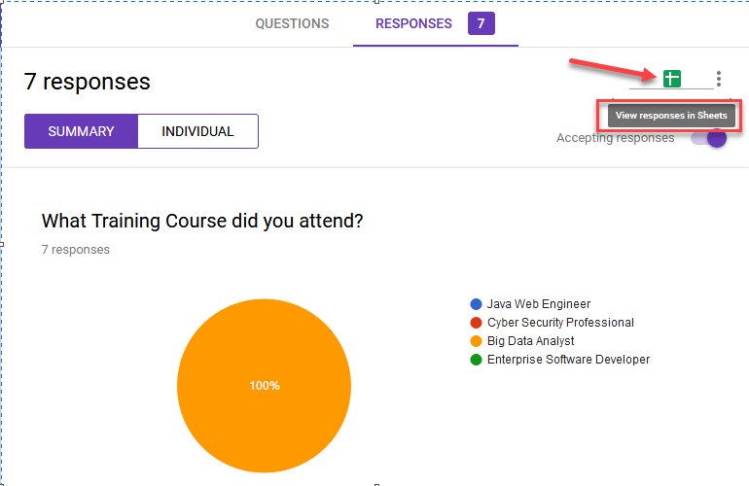
Create a Spreadsheet in “Google Sheets”

Slide 11
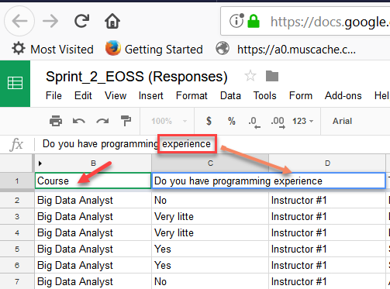
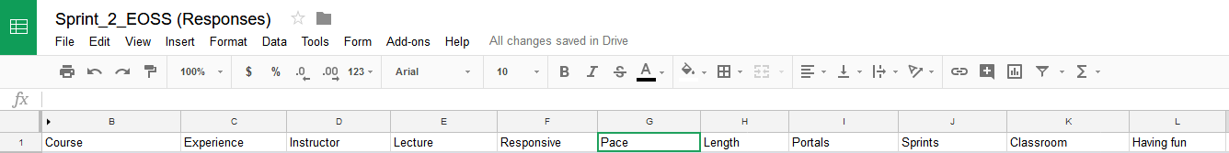
Shorten Questions (Column Headers) to One or Two Words

Slide 12
View(Sprint_2)
Determine Working Directory and Read Google Sheet file in R
getwd()
Install.packages(“googlesheets”)
library(googlesheets)
gs_ls()
Sprint_2 <-’https://docs.google.com/spreadsheets/d/1Oze5HnI8jEVtKvhwt2LbO42Ec5ErHI6_IArt3sS7HxY/edit#gid=319180982’
Sprint_2 <- gs_title(“Sprint_2_EOSS (Responses)”)
Sprint_2 <- gs_read(ss=Sprint_2, ws = "Form Responses 1")
Sprint_2
View(Sprint_2)

Slide 13
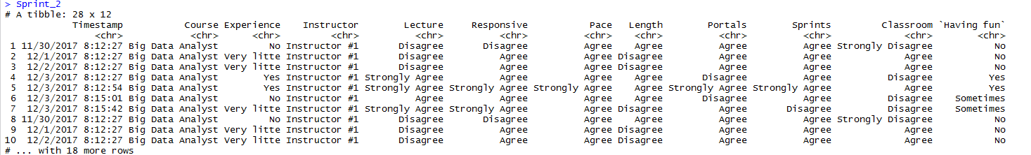
Reading the Google Sheet file in R

Slide 14
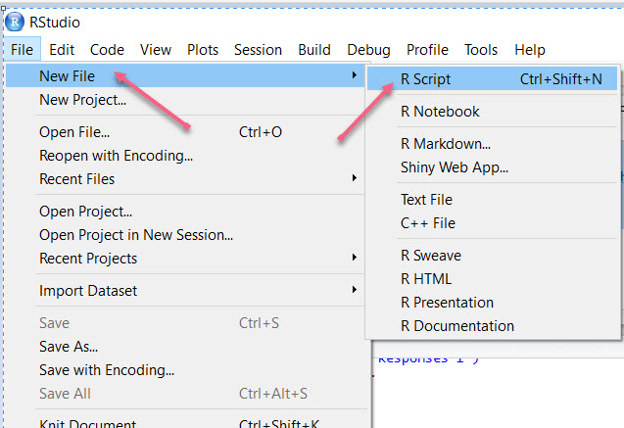
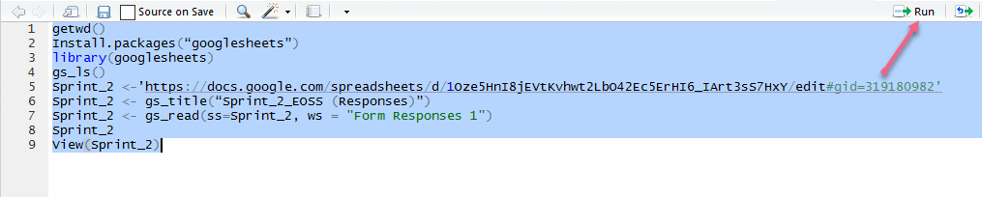
Write a “Script” in R to Speed-up the Process of Reading the Data

Slide 15
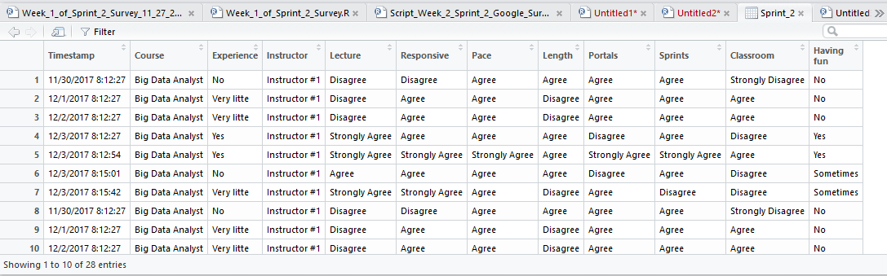
View the (Survey) Data in R

Slide 16
Thank you

